Slide 1
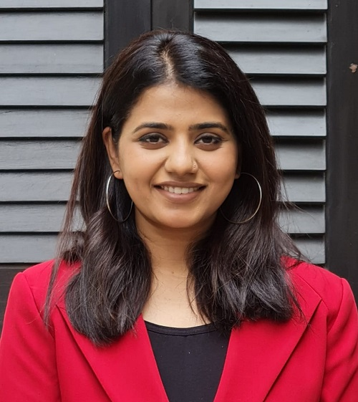
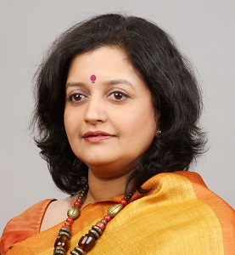
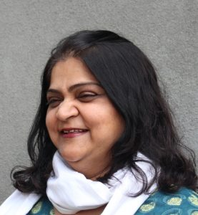
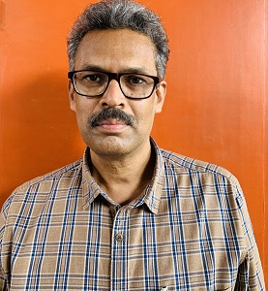
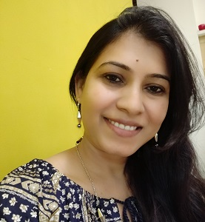
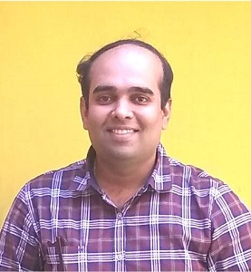
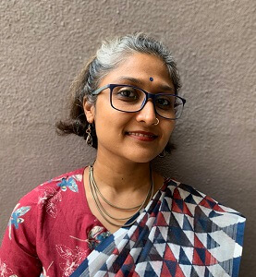
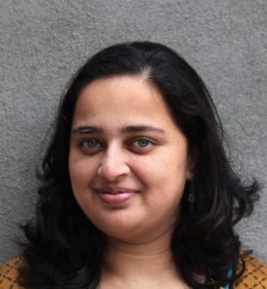
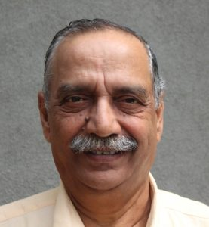
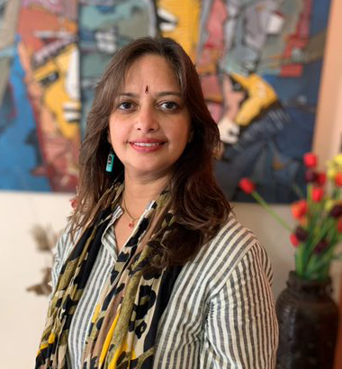
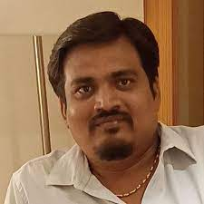
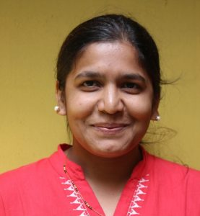
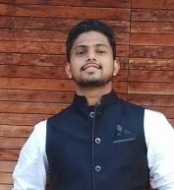
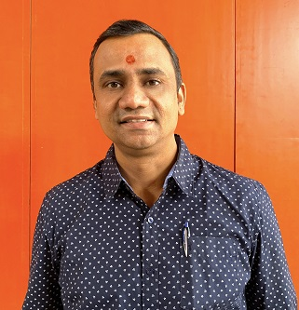
T Q A T
I Q A C
Internal Quality Assurance Committee , Year 2022-23
Ms. Pooja Misal
Director, S.M.E.F.’s Brick Group of Institutes
Dr. Poorva Keskar
Principal, S.M.E.F.’s Brick School of Architecture
Ar. Manali Deshmukh
Vice Principal, S.M.E.F.’s Brick School of Architecture
Ar. Shraddha Manjrekar
IQAC Coordinator, S.M.E.F.’s Brick School of Architecture
Ar. Abhang Kamble
Design Chair, S.M.E.F.’s Brick School of Architecture
Dr. Vaidehi Lavand
Research Cell Head, S.M.E.F.’s Brick School of Architecture
Ar. Sudhir Deshpande
Examination Cell Head, S.M.E.F.’s Brick School of Architecture
Ar. Ketaki Gujar
Publication Cell Head, S.M.E.F.’s Brick School of Architecture
Ar. Sharduli Joshi
Academic Committee Member, S.M.E.F.’s Brick School of Architecture
Ar. Vishwas Kulkarni
Industrialist and Employer
Director, VK A Architecture
Dr. Shruti Nigudkar
Stakeholder, Head of MIT WPU School of Visual Arts – Fine Arts
Mr. Amol Umbarje
NGO representative
Sustainability Initiatives, Pune
Ms. Rupali Dhanwade
Admin Representative, S.M.E.F.’s Brick School of Architecture
Ar. Bhairumal Sutar
Alumni, S.M.E.F.’s Brick School of Architecture
Mr. Swapnil Wagh
Student, S.M.E.F.’s Brick School of Architecture
Mr. Chandan Chaughule
Admin Representative, S.M.E.F.’s Brick School of Architecture

